Slide 1
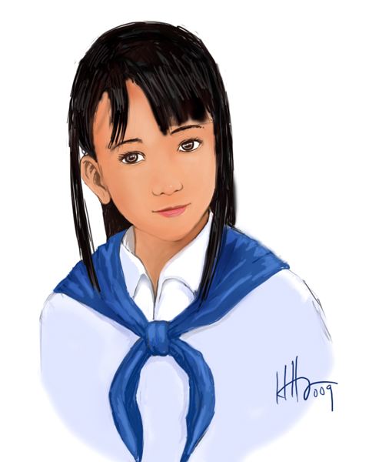
Eucharistic Youth: How, Why, and What
Notes:
How we form Thieu Nhi.
What do we do to teach & to have fun
Why we want/need Thieu Nhi.
History. Promise to have fun. 3D.

Slide 2
1929: Started as Eucharistic Crusade
Croisade Eucharistique.
Notes:
Last king.
Chinese. Influenced by Chinese culture. Watch for the end of video.

Slide 3
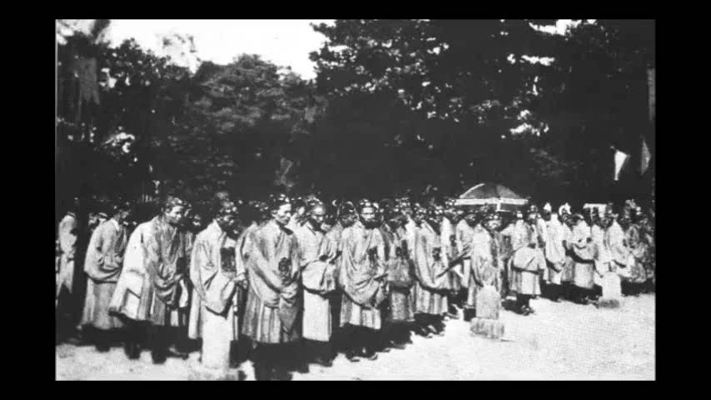
1929: Started as Eucharistic Crusade
Notes:
Chinese. Influenced by Chinese culture. end of video.

Slide 4
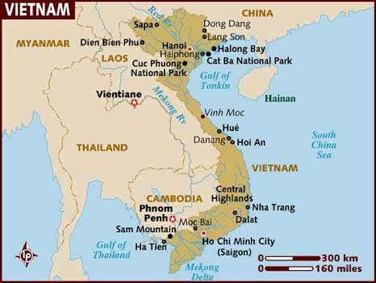
1929: Started as Eucharistic Crusade
Notes:
Video here
Look like French.
Do`ng. French in Vietnam. Spread regious idea in school. Binh. Not same as Crudsade. Crusade against sins with prayers and eucharist. Ha Noi. A bit Diff in France. Priests… spead. Phát Diệm, Thanh Hoá
Why we march and salut. TNTT: Purpose was to pray, especially to the Blessed Sacrament, for the conversion of hearts and the reconciliation among youths

Slide 5
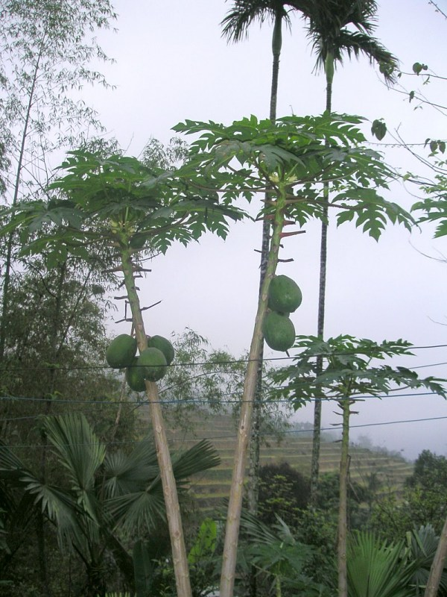
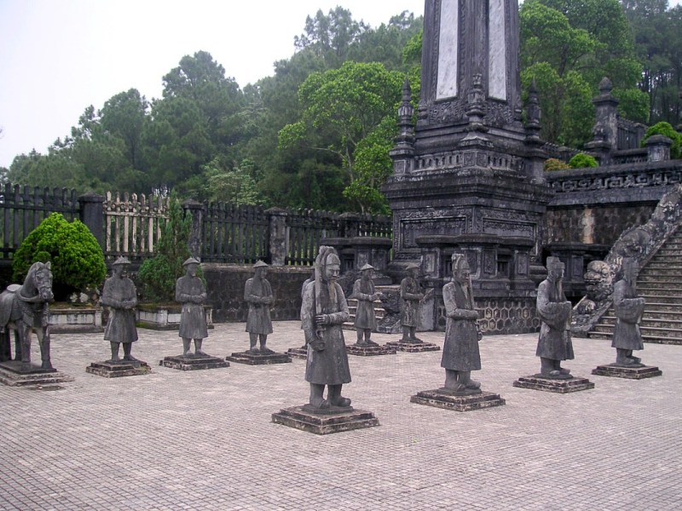
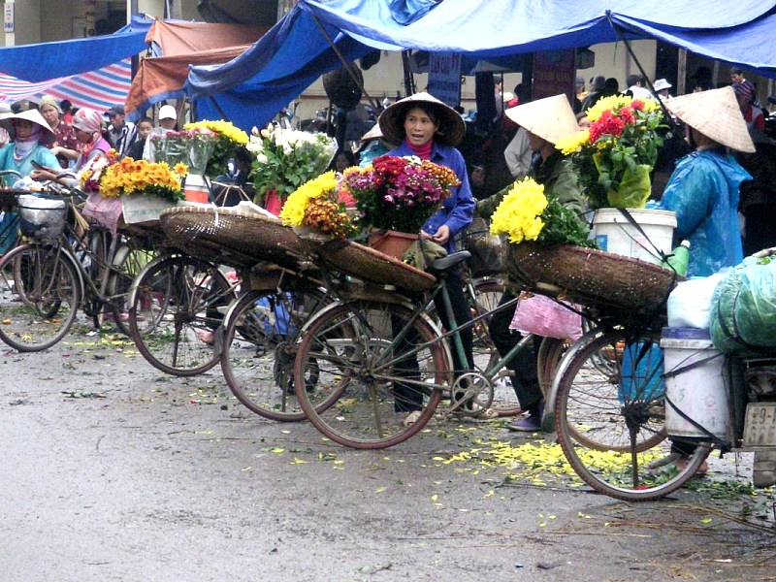
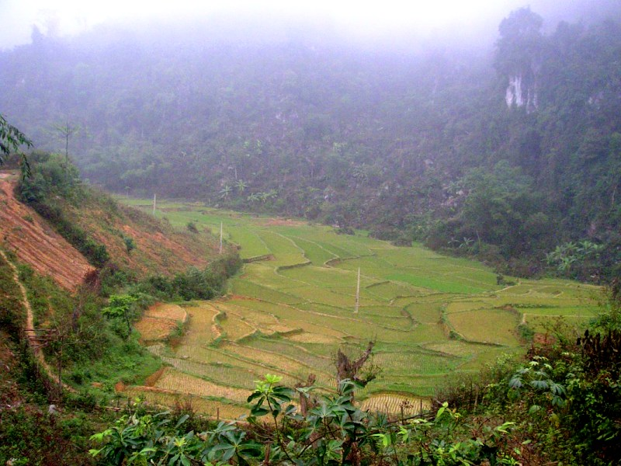
1935-1975: Growth and Spread
Notes:
More than praying, also focus on apostolic services (going out to help people).
Conflict between conflict between North south, move and established in 650 parishes in South Vietnam.
Who born in Vietname? Born here? Visit Vietnam?
Hanoi, Hanoi country side (2)… what tree, Hue^ (1931).

Slide 6
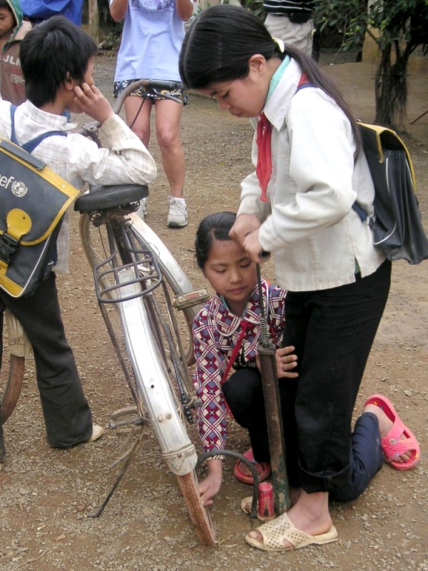
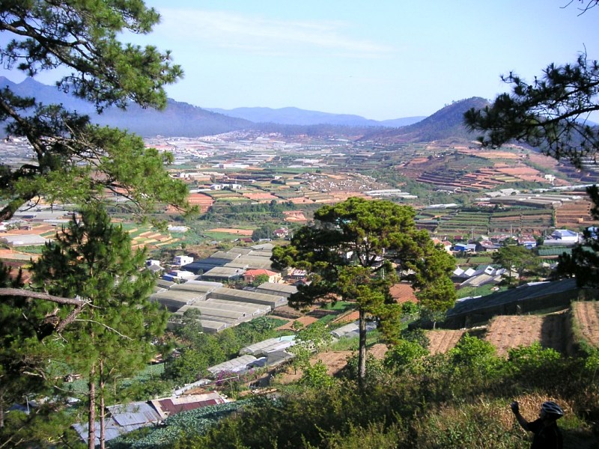
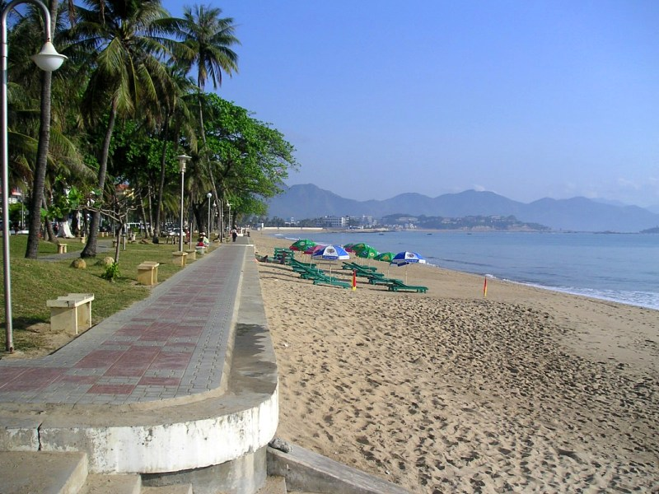
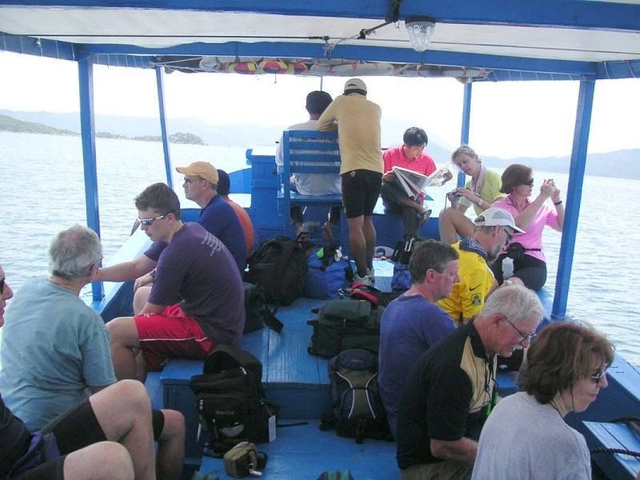
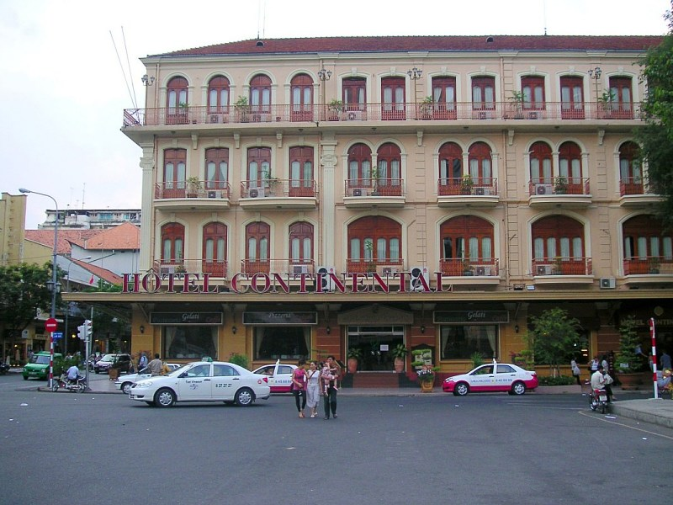
1935-1975: Growth and Spread
Notes:
Da lat, Nha Trang (2)… kids on country side - bycicle, Saigon (1935). Who has been? TN were here.

Slide 7
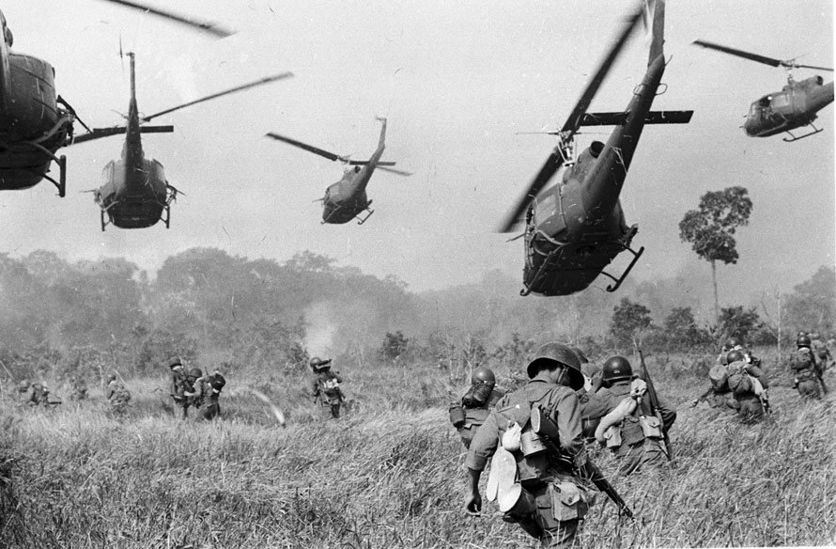
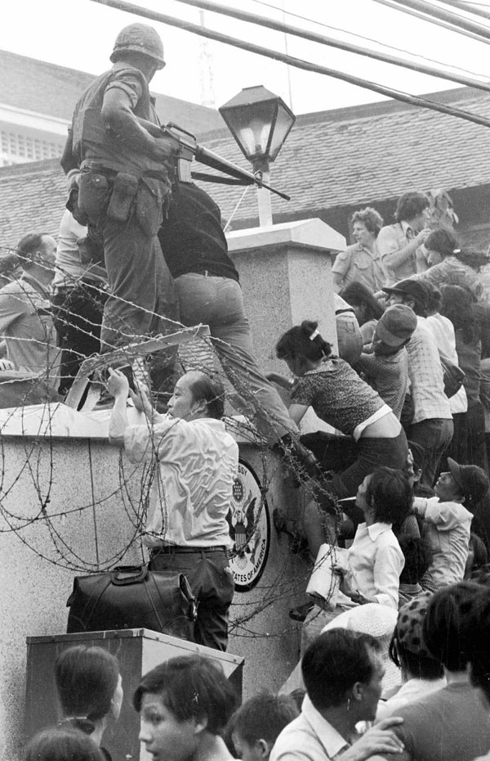
1975: Fall of South Vietnam. Spread throughout the world
Notes:
Parent talks to you about war? Why family moved to the US?
Thieu Nhi spreads with refugees to Australia, Cana, Europe, United States… Established in over 70 communities and parishes in the United States

Slide 8
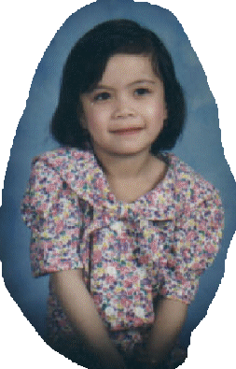
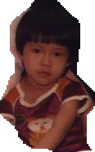
1980: Huynh Trưởng, leaders
1987
1981
Notes:
Guess who was born in 1981….

Slide 9
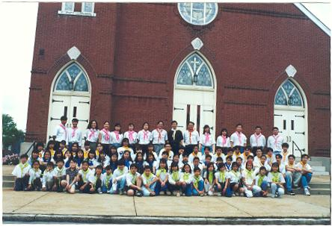
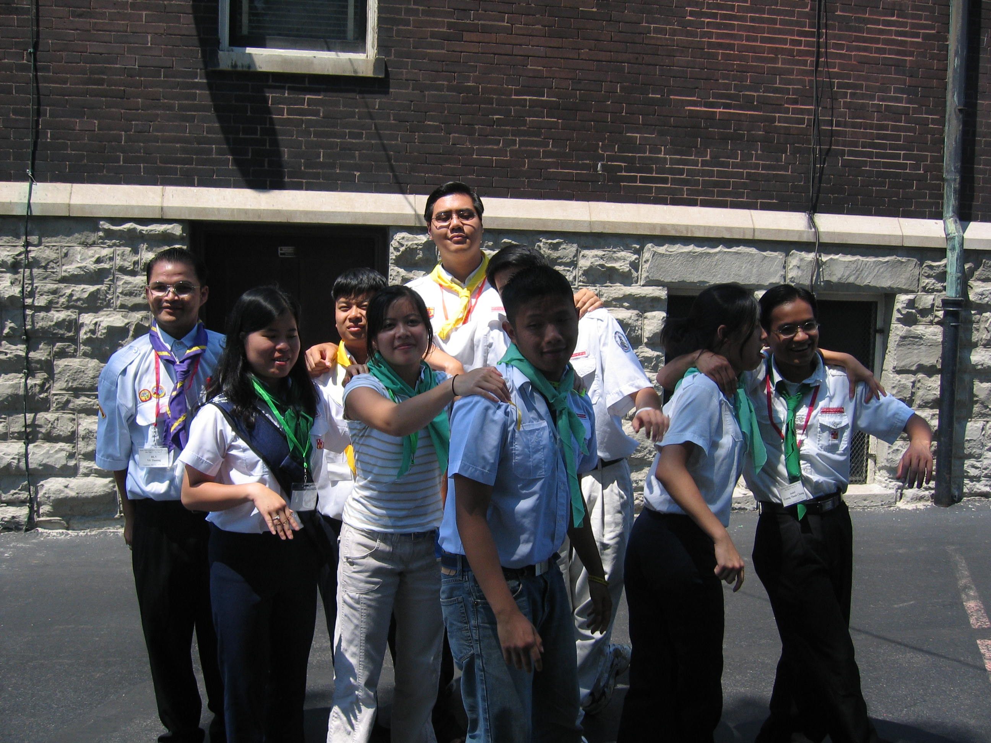
1996: Thiếu Nhi came to Saint Louis
That’s me! 10 years ago

Slide 10

Hiệp Sĩ
2007
Notes:
Trick. Look closer

Slide 11
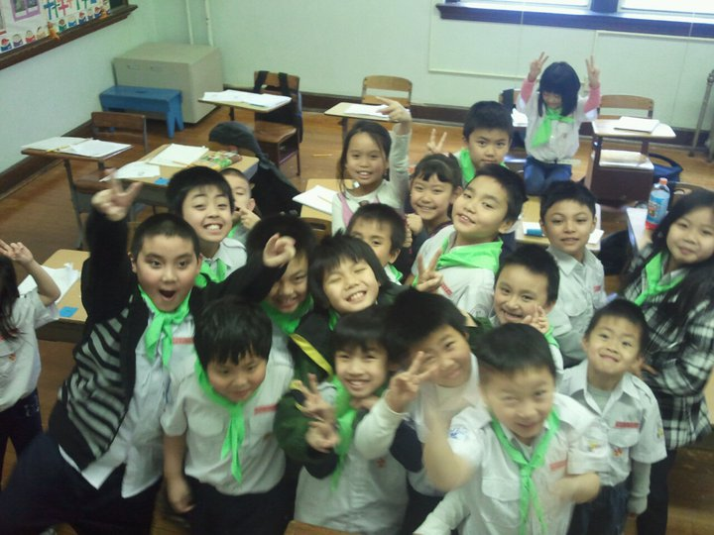
Thiếu Nhi – How We Organize
1. SEEDLING / ẤU NHI (7-9 years old):
active, curious, and annoying.
Notes:
Who has brother and sister in Thieu Nhi?

Slide 12
Thiếu Nhi – How We Organize
2. SEARCH / THIẾU NHI (10-12 years old): Changing and growing.
2000
1998
1999
2001
1996
1997
Notes:
Seriously. Calm down. We do organize by 3 Nga`nh.
Who was born in these years?

Slide 13
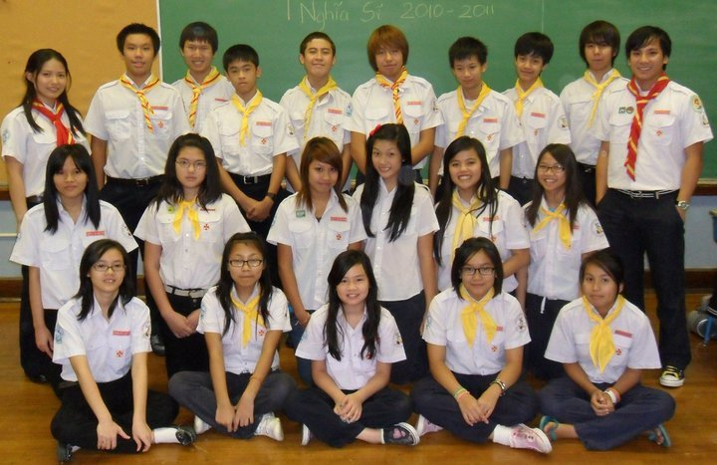
Thiếu Nhi – How We Organize
3. COMPANION / NGHĨA SĨ (13-15 years old): Growing into young adults.
Saint Louis Chapter, Regional, National
Notes:
Who has brother and sister in Nghia Sy?

Slide 14


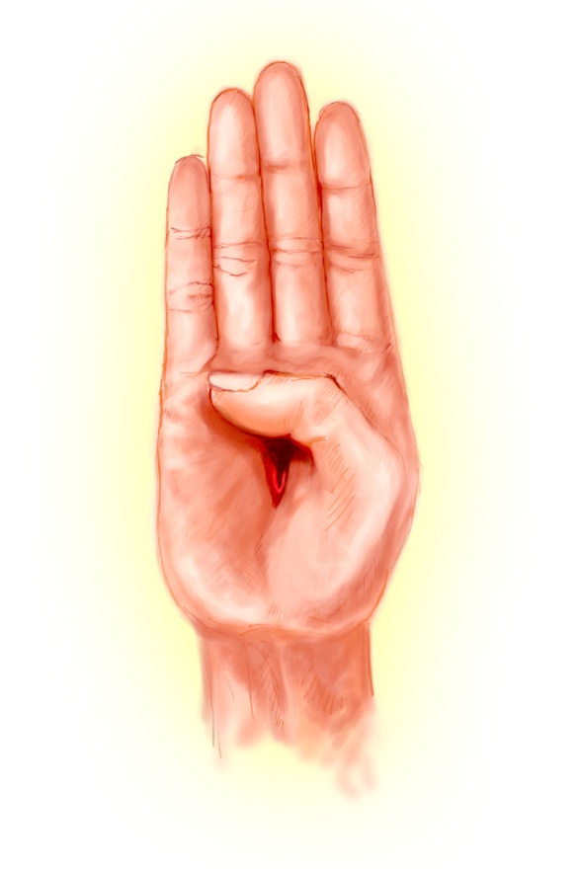
What We Do : Eucharistic Youth
Help us in our spiritual and social life and help us become good kids.
Promote Vietnamese culture and to work with others.
Notes:
Show. Picture first.
Social, Spiritual
What You good at.

Slide 15
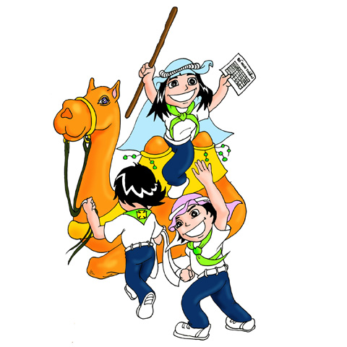
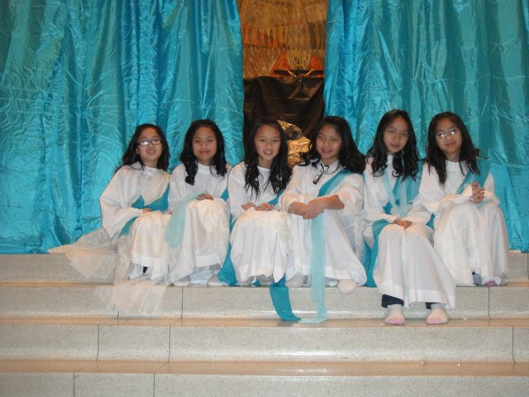
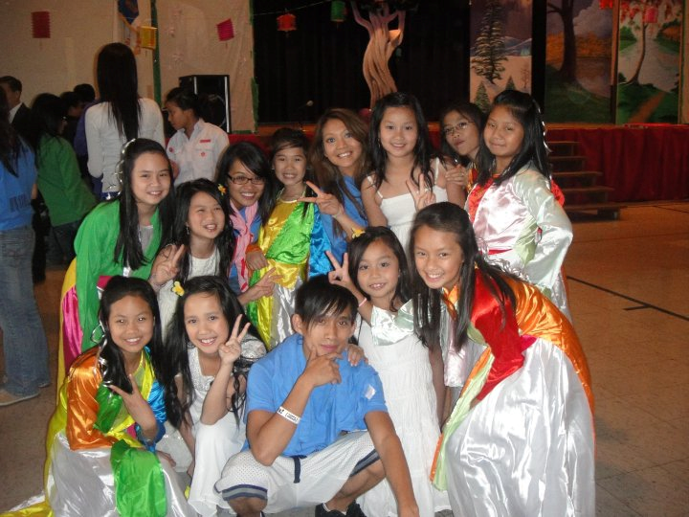
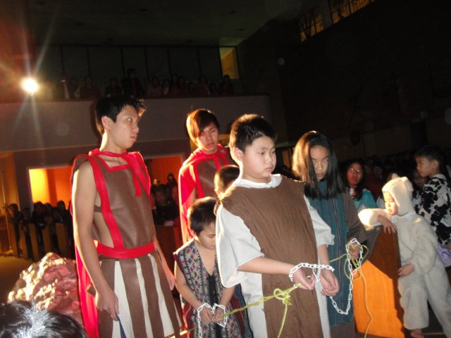
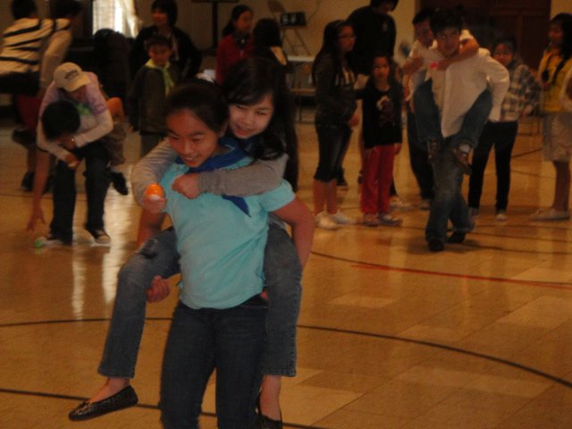
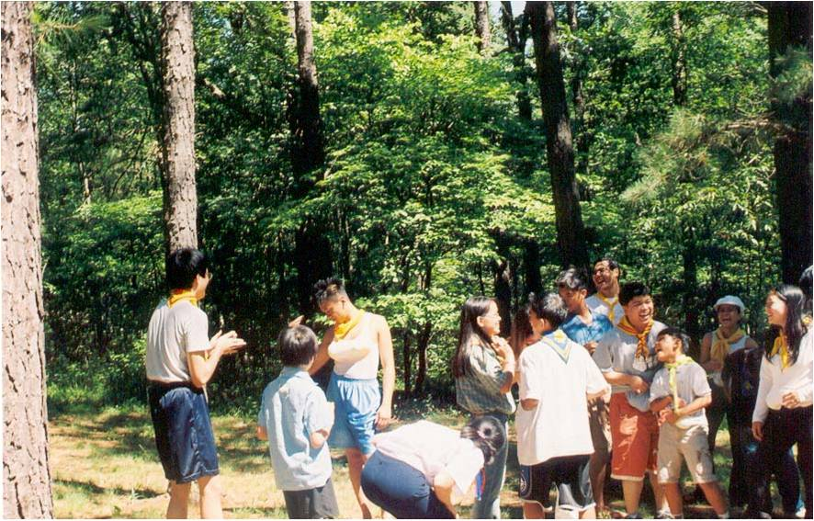
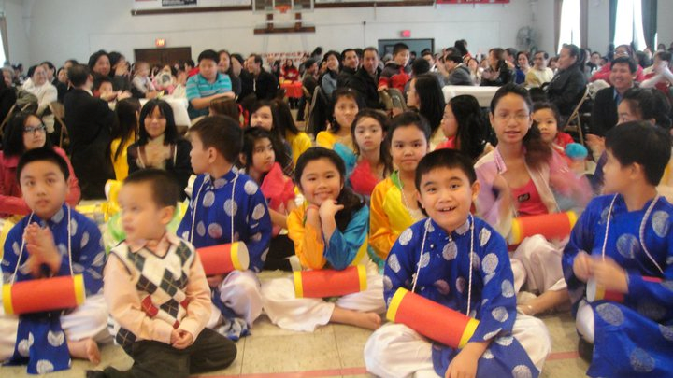
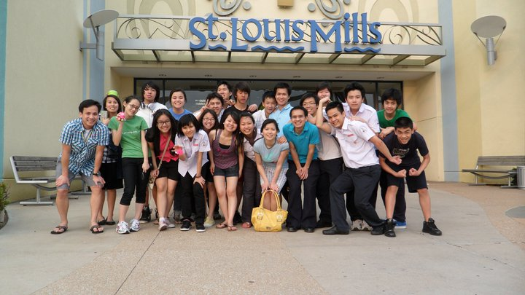
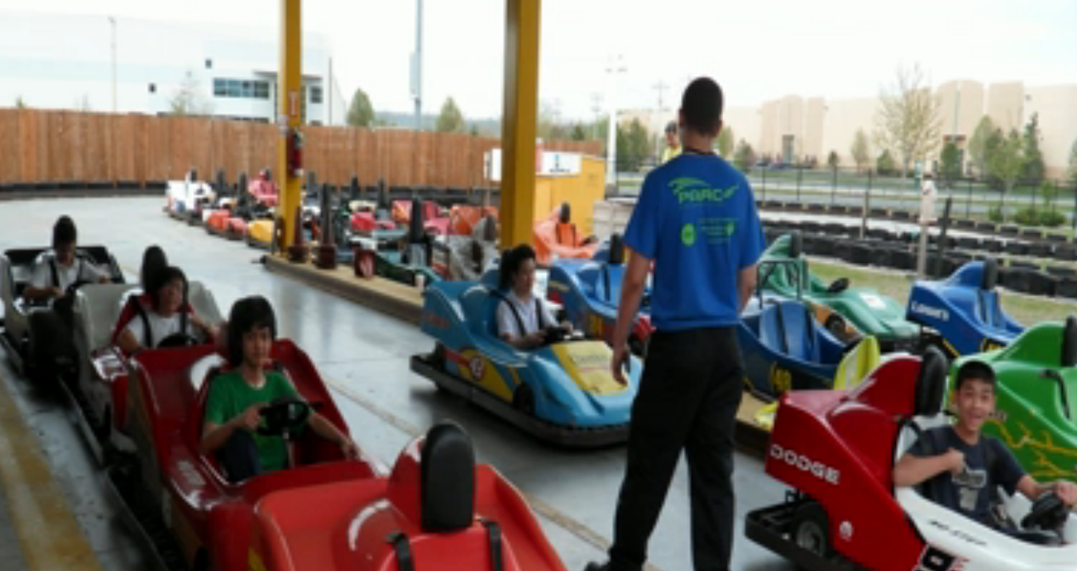
What We Do
Church.
Lessons, games, activities…
Camping, fiend trips …
Notes:
Camping. Go.

Slide 16
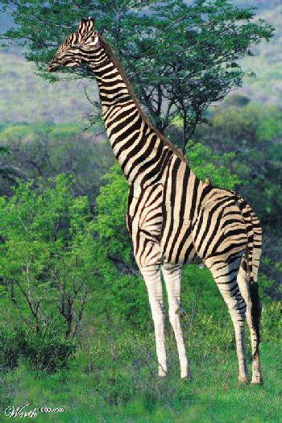

Done
There is something wrong with me. Can u guess?
Notes:
Trick. Look closer

